Slide 1
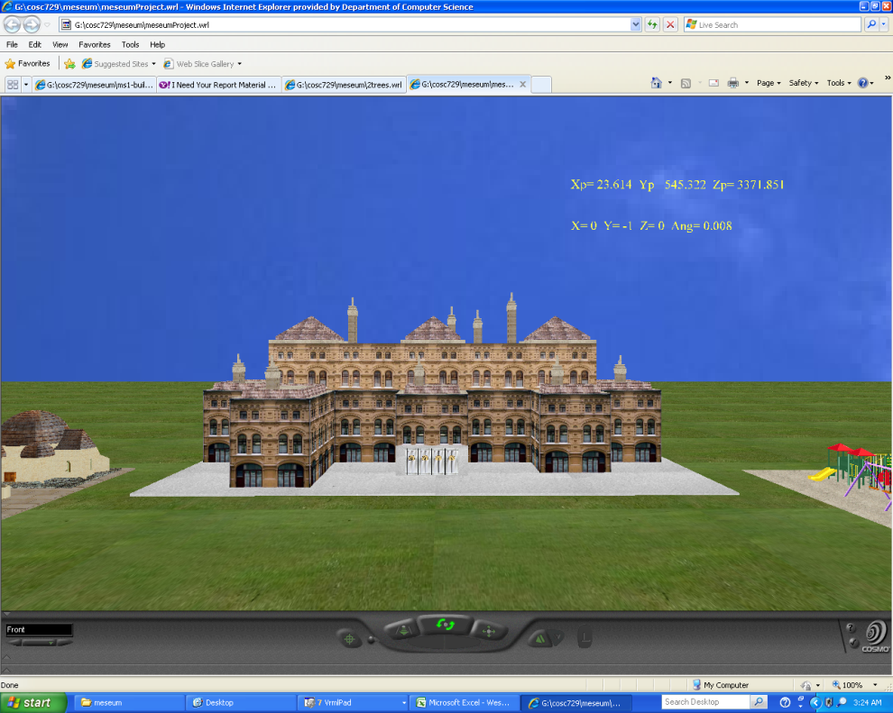
Virtual Children’s
Museum
Project Report
COSC 729/490
Spring 2010
Group Members:
Bette Donahue
Daryl Davis
Tyreek Edward
Emily Mudede

Slide 2
Goals and Objectives
Create virtual museum that will:
Allow users to explore various rooms
Play with various objects and games
View various real-world objects

Slide 3
Modeling
Outside Area
Lobby
Kid’s Room
Obstacle Course
Treasure Hunting Room
3D Maze

Slide 4

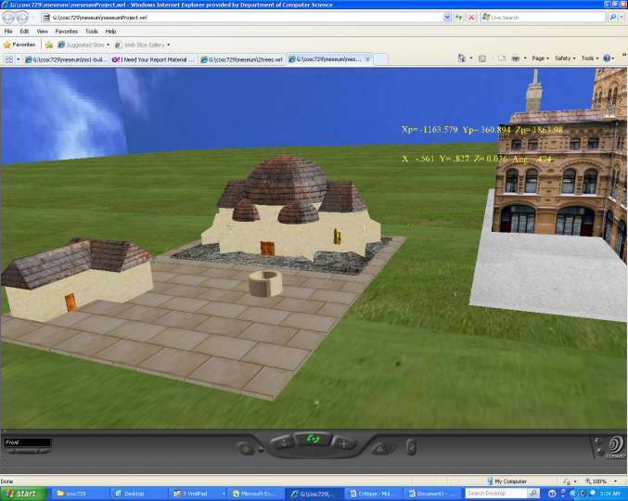
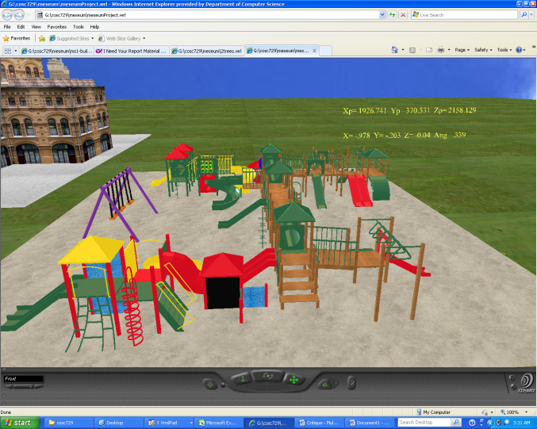
Outside Region
Objects: buildings
Images: museum exterior
Textures: see links below
Sensors: touch sensors and anchors
Links: http://www.greatbuildings.com

Slide 5
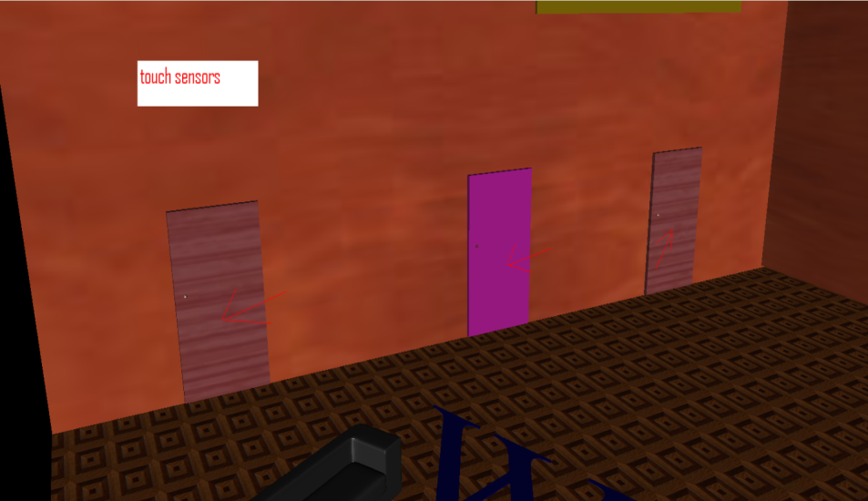
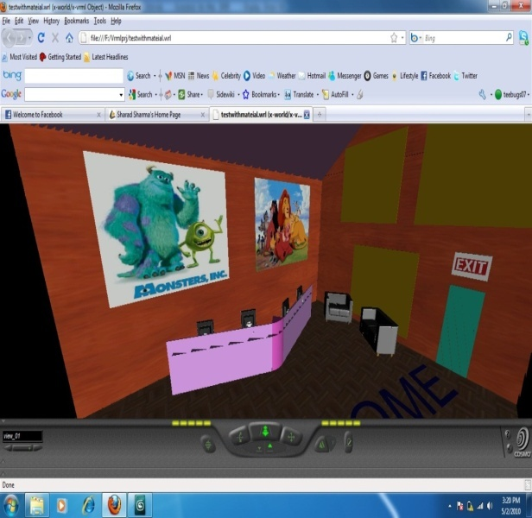
Lobby
Objects: couches, posters and airplane
Images: Monsters Inc. and Lion King
Textures: see links below
Sensors: touch sensors, cylinder sensors and anchors
Lights: spot and point lights

Slide 6
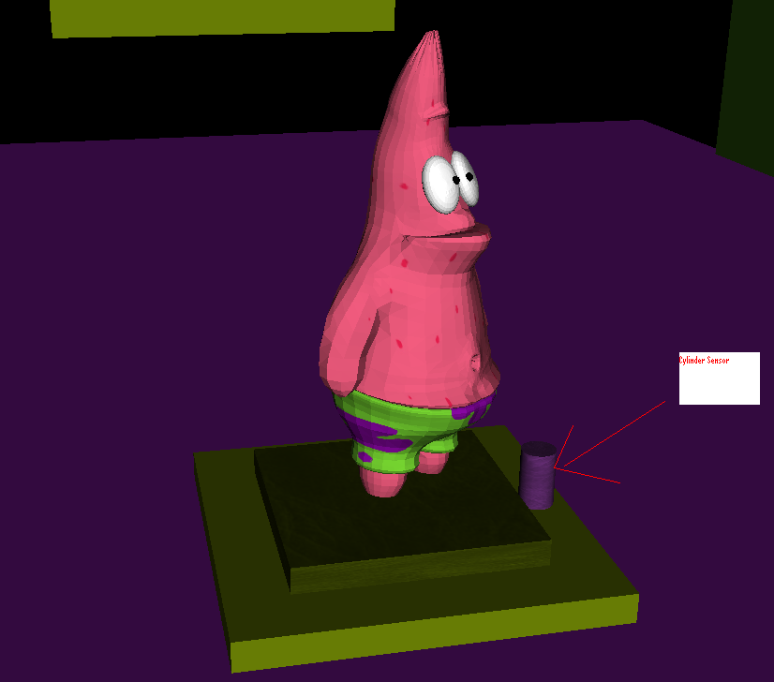
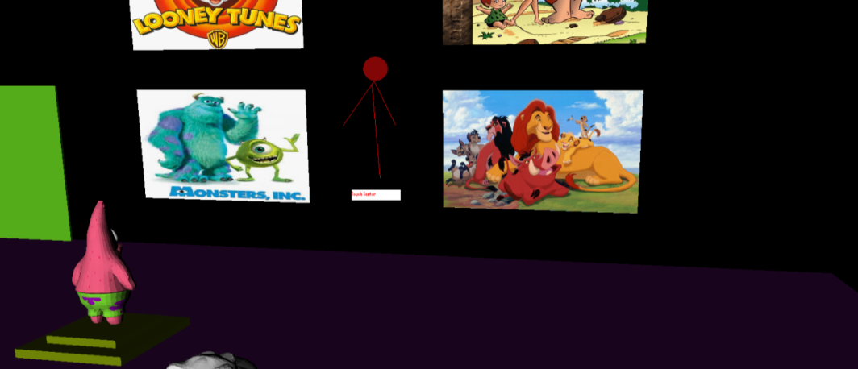
Kid’s Room
Objects: posters and statues: Patrick Star, Peter Griffem, Harry Potter’s Dobby
Images: Monsters Inc. and Lion King
Textures: see links below
Sensors: touch sensors, cylinder sensors and anchors
Lights: spot and point lights

Slide 7
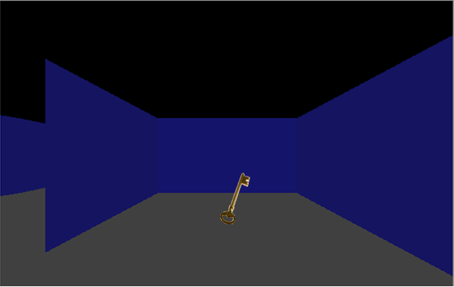
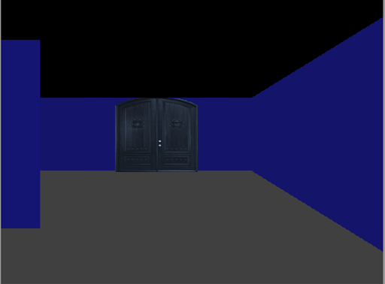
3D Maze
Sensors: touch sensors, anchors, and proximity sensors
Images: key and door
Lights: point and directional lights
Objects: key, door

Slide 8
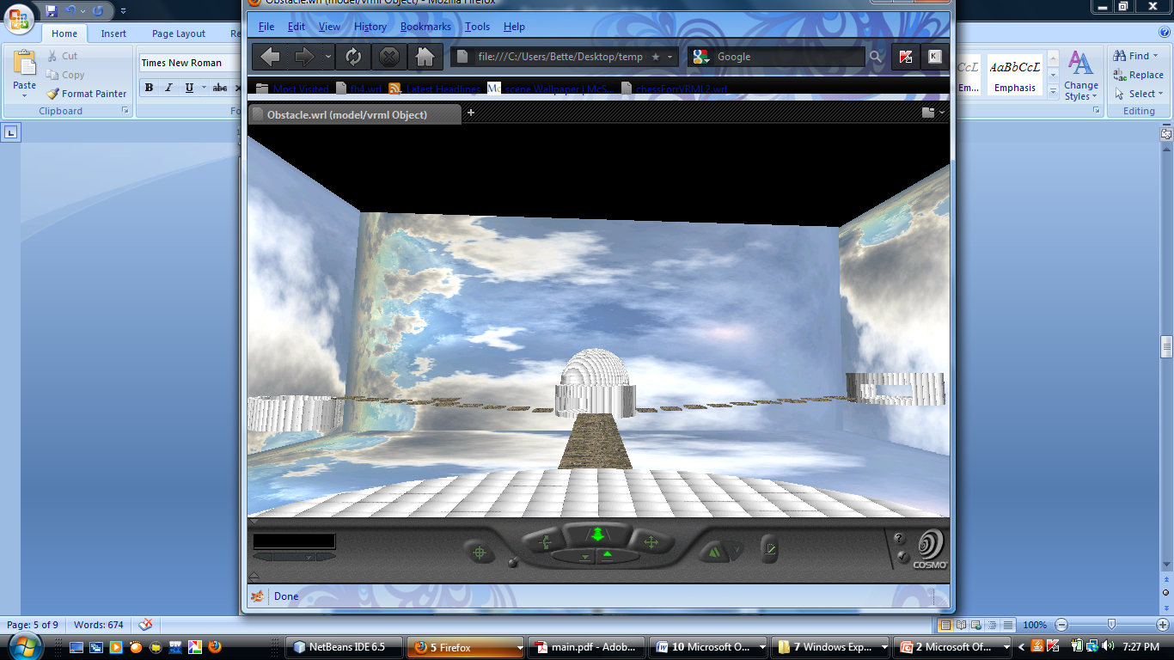
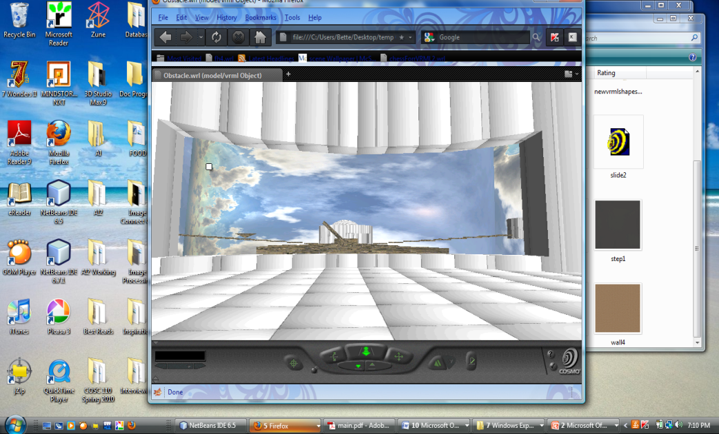
Obstacle Course
Textures: 3ds Max 2009, http://twistedphysics.typepad.com/cocktail_party_physics/images/butterfly.jpg
Sensors: touch sensors, orientation and position interpolators and anchors
Lights: point and directional lights
Links: http://www.matryx.net/vrml/ butterfly
http://www.musicandvirtualflowers.co.uk/virtualflower/index.htm flower

Slide 9
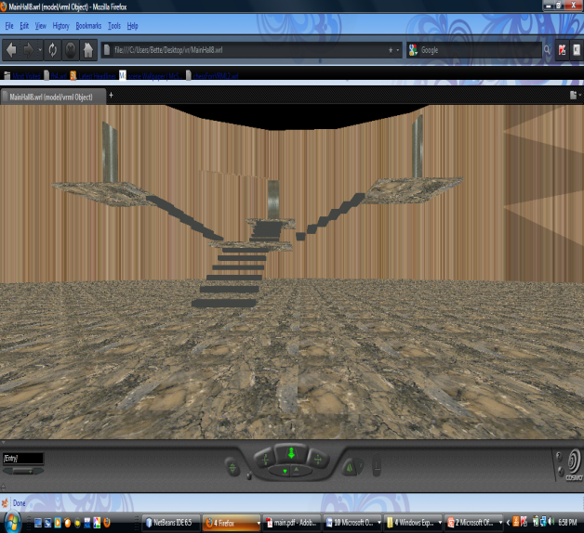
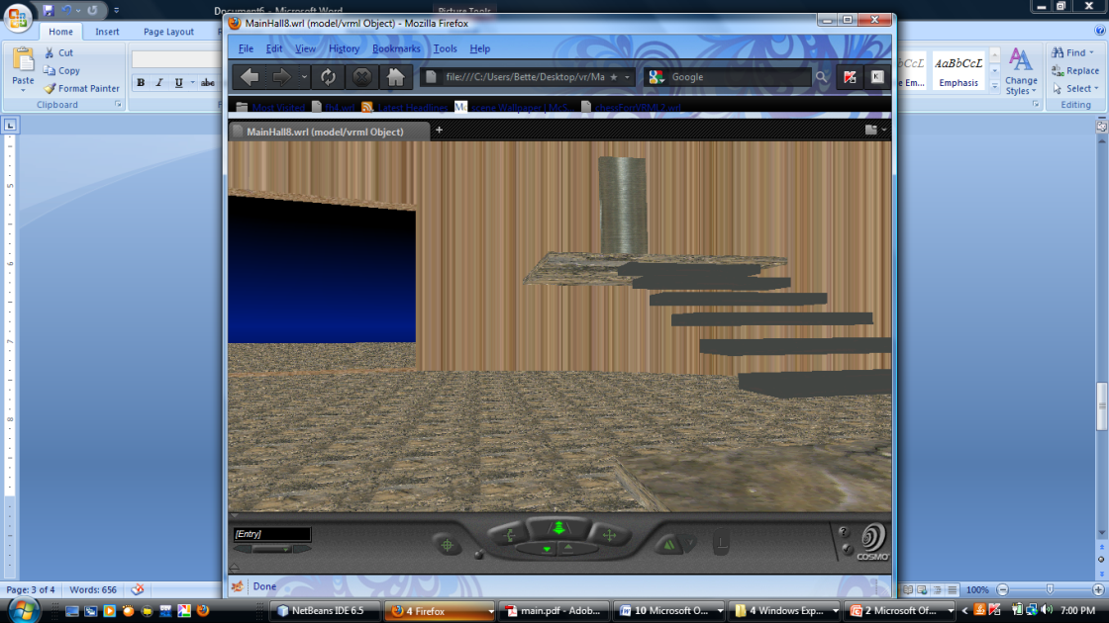
Treasure Hunting Room
Textures: 3ds Max 2009
Sensors: touch sensors, orientation and position interpolators and anchors
Lights: point and directional lights
Links: http://www.musicandvirtualflowers.co.uk/virtualflower/index.htm moving shape rooms

Slide 10

Demo

